Slide 1
Measurements and Errors

Slide 2
Let’s Review Measurements:
Measurement is the comparison of quantity with standard quantity. (standard quantity that is acceptable for every one)
For example:
2 kg sugar must be compare with 2kg standard weight.
The Merits:
Measurements are essential for development of science and technology.
A reliable measurement can generate reliable information.
Every measurement has UNITS.
Every measurement has UNCERTAINTY

Slide 3
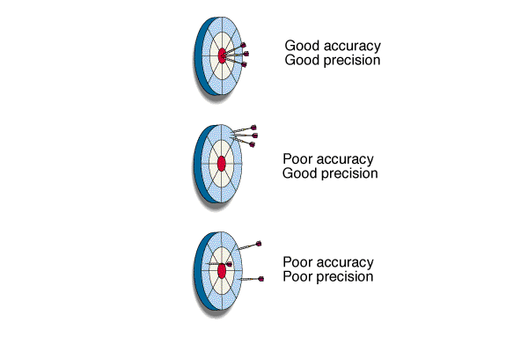
Accuracy and Precision in Measurements
Accuracy: how close a measurement is to the accepted value.
Precision: how close a series of measurements are to one another or how far out a measurement is taken.

Slide 4
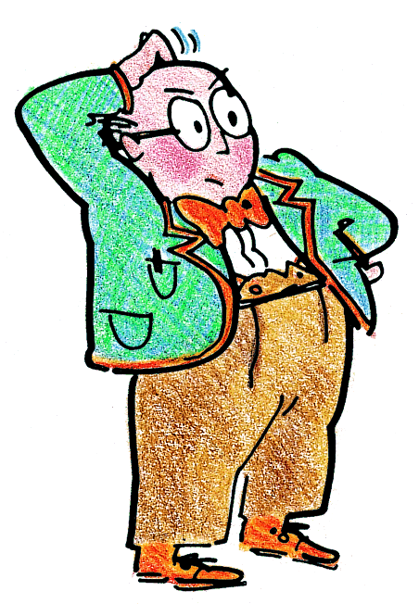
What is an error?
An error is a mistake of some kind...
…causing an uncertainty in your results…
…so the result is not accurate.

Slide 5
Errors
Error of measurement refers to the difference between the measurement we obtain and the "true" value of the variable.
Question: How do you get the "true" measure if all measuring methods produce errors?
Answer: "True" measures cannot be obtained, but they can be estimated.

Slide 6
Determining Error
Suppose you use a thermometer to measure the boiling point of pure water at standard pressure.
The thermometer reads 99.1°C.
You probably know that the true or accepted value of the boiling point of pure water at these conditions is actually
100.0°C.

Slide 7
Determining Error
There is a difference between the accepted value, which is the correct value for the measurement based on reliable references, and the experimental value, the value measured in the lab.
The difference between the experimental value and the accepted value is called the error.
Error = experimental value – accepted value

Slide 8
Determining Error
For the boiling-point measurement, the error is
99.1°C – 100°C, or –0.9°C.

Slide 9
What is an error?
Some are due to human error…
For example,
by not using the equipment correctly
Let’s look at some examples.

Slide 10
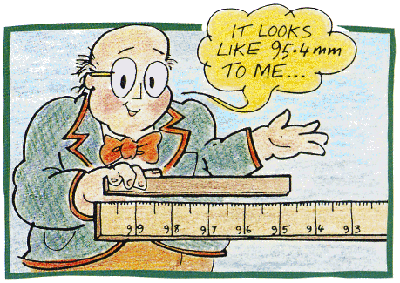
Human error
Example 1
Professor Messer is trying to measure the length of a piece of wood:
Discuss what he is doing wrong.
How many mistakes can you find? Six? Seven?

Slide 11
Human error
Answers:
Measuring from 100 end
95.4 is the wrong number
‘mm’ is wrong unit (cm)
Hand-held object, wobbling
Gap between object & the rule
End of object not at the end of the rule
Eye is not at the end of the object (parallax)
He is on wrong side of the rule to see scale.
How many did you find?

Slide 12
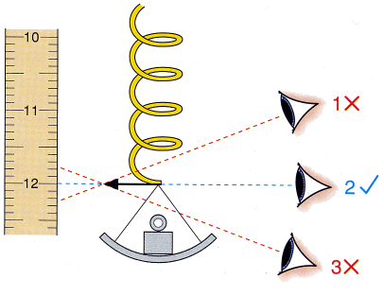
Human error
Example 2
your eye
Reading a scale:
Discuss the best position to put your eye.

Slide 13
Types of errors
When reading scales,
there are 2 main types of error:
Random errors
Systematic errors.
Let’s look at some examples . . .

Slide 14
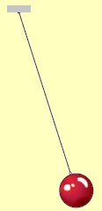
Random errors
These may be due to
human error,
a faulty technique,
or faulty equipment.
When timing a pendulum
you may start the stopwatch
too soon, or too late, randomly.

Slide 15
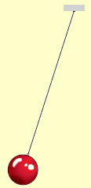
Random errors
To reduce the error, take a lot of readings,
and then calculate the average (mean).
For example, suppose the 6 results from timing 20 swings of a pendulum are:
21.7s 21.5s 22.1s 21.5s 21.6s 21.8s
We can get a more accurate value by calculating the mean (average), like this:
Time for 20 swings
₌ 21.7 + 21.5 + 22.1 + 21.5 + 21.6 + 21.8 ₌ _{21.7 s}
6

Slide 16
Systematic errors
These errors cause readings to be shifted one way (or the other) from the true reading.
Your results will be systematically wrong.
Let’s look at some examples . . .

Slide 17
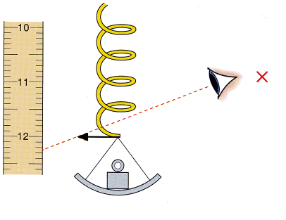
Systematic errors
Example 1
If you have a parallax error:
with your eye always too high
then you will get a systematic error
All your readings will be too high.

Slide 18
Systematic errors
A particular type of systematic error
is called a zero error.
Here are some examples . . .

Slide 19
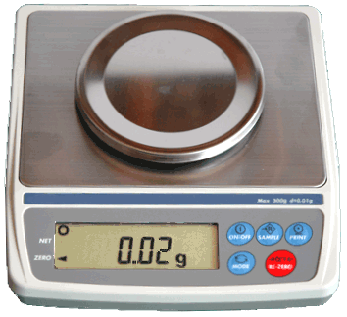
Zero errors
Example 2
Look at this top-pan balance:
It has a zero error.
There is nothing on it, but it is not reading zero.
What effect do you think this will have on all the readings?

Slide 20
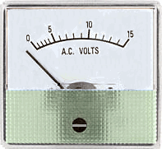
Zero errors
Example 3
Look at this voltmeter:
What is the first thing to do?
Use a screwdriver here to adjust the pointer.

Slide 21
In summary
Human errors can be due to faulty technique.
Random errors can be reduced by taking many readings, and then calculating the average (mean). The uncertainty is half the range.
Systematic errors, including zero errors, will cause all your results to be wrong.

Slide 22
Measurements Systems

Slide 23
Let’s Review Measurements:
Measurement is the comparison of quantity with standard quantity. (standard quantity that is acceptable for every one)
For example:
2 kg sugar must be compare with 2kg standard weight.
The Merits:
Measurements are essential for development of science and technology.
A reliable measurement can generate reliable information.
Every measurement has UNITS.

Slide 24
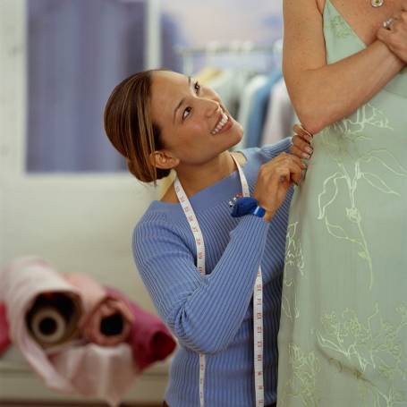

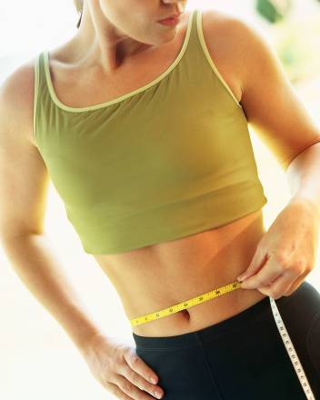
Why Learn to Measure?
Valuable skill for a job
Valuable skill for hobbies
Valuable skill for every day life
Notes:
“Although you are probably familiar with rulers, yard sticks, tape rules, folding rules, and tape measures, you will also find rulers on many machines that you use such as saws, sewing machines, photocopiers, and computer scanners. Computer programs like Microsoft Word and Adobe PhotoShop have electronic rulers that you can turn on to help you with the exact placement of items. As you can tell, reading a ruler is a valuable skill that you will use almost every day both on and off the job.”
http://www.rickyspears.com/rulergame/

Slide 25
Measurements Systems
1 MKS System
2 CGS System
3 FPS System/ British Engineering System
4 SI Units

Slide 26
FUNDAMENTAL‌ PHYSICAL QUANTITIES
A physical quantity which defined independently and considered as fundamental quantities all over the world is known as fundamental physical quantities.
Example: Length, Mass, Time, Electric Current, Amount of substance, Luminous Intensity, Temperature.

Slide 27
DERIVED‌ PHYSICAL QUANTITIES:
Physical quantities which came into being by the help of fundamental physical quantities are known as derived physical quantities.
Example: Velocity, Acceleration, Force, Momentum , Torque. etc.

Slide 28
Units of Measurement
Measurements involve NUMBER and UNIT
Represent a quantity: has magnitude, size, or amount
Gram = unit of measurement
Mass = quantity

Slide 29
Units of Measurement
Scientists around the world agree on one system…
International System of Units
( Systeme International Unites)
SI units
Built from seven base units

Slide 30
MKS System
MKS
Length Meter m
Mass Kilogram kg
Time Second s

Slide 31
CGS System
CGS
Length Centimeter cm
Mass Gram g
Time Second s

Slide 32
FPS System
FPS
Length Foot f
Force Pound lb
Time Second s

Slide 33
The system which is adopted all over the world from 1960 is called system of international units 'S.I. Unit'.

Slide 34
The Seven Base SI Units
Quantity | Unit | Symbol
Length | meter | m
Mass | kilogram | kg
Temperature | kelvin | K
Time | second | s
Amount of Substance | mole | mol
Luminous Intensity | candela | cd
Electric Current | ampere | a

Slide 35
METER:
A meter is defined as the distance between two marks
on Platinum Iridium bar kept at 0 °C in the international Bureau of weights and measures near Paris.
In 1960 to choose a particular wavelength of light to standardised that meter, thus
1m = 165076373 wavelength of krypton (Kr) radiation.
KILOGRAM:
The mass of cylinder of specific dimension of platinum iridium alloy kept in the international bureau of weights and measurement near Paris is taken to be the standard one kilogram.

Slide 36
SECOND
For scientific work second was defined as 1/86400 of a mean solar day.
But now second is defined in terms of time period of certain atom (Cesium-133-Cs-133). One second is 9,192,631,770 period of vibrations of Cs-133.
Kelvin
is defined as (1/273.15) of the temperature of the triple point of water.

Slide 37
Mole
A mole is defined as the amount of a substance that contains 6.022 X10²³ entities like particles, atoms, ions, molecules, etc. of the given substance.
A mole is defined as the amount of a substance that contains as many elementary entities as there are atoms in 0.012 of carbon-12

Slide 38
Candela
The candela is the luminous intensity in a given direction of a source that emits monochromatic radiation of frequency 540 x 10¹² hertz and that has a radiant intensity in that direction of 1/683 watt per steradian.

Slide 39
AMPERE
When one coulomb charge (6.24 x 10¹⁸ charge carriers) flows through an electric circuit in one second, then the current flowing through the circuit is said to be one ampere.

Slide 40
Derived SI Units (examples)
Quantity | unit | Symbol
Volume | cubic meter | m3
Density | kilograms per cubic meter | kg/m3
Speed | meter per second | m/s
Force | kg m/ s2 | N
Energy | Joule (kg m2/s2) | J
Pressure | Pascal (kg/(ms2) | Pa

Slide 41
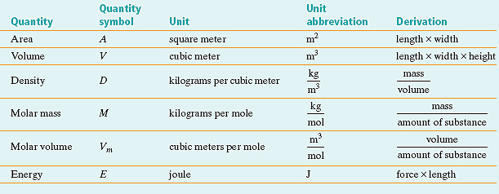
Derived Units

Slide 42
Supplementary quantities
The dimensionless units have been combined alongside base units just to generate derived units are known as supplementary quantities.
Supplementary quantities are of two types:
Plane angle - radian (rad)
Solid angle - steradian (sr)

Slide 43
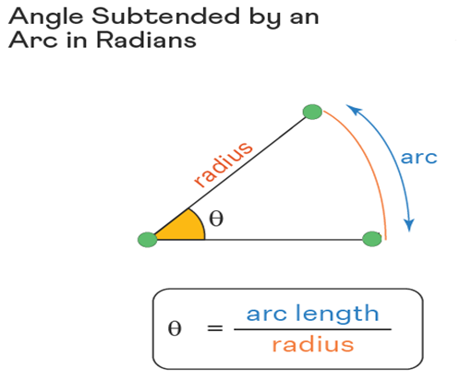
The radian is an S.I. unit that is used to measure angles and one radian is the angle made at the center of a circle by an arc whose length is equal to the radius of the circle.
One radian is equal to 180/π degrees, which is approximately 57.3∘

Slide 44
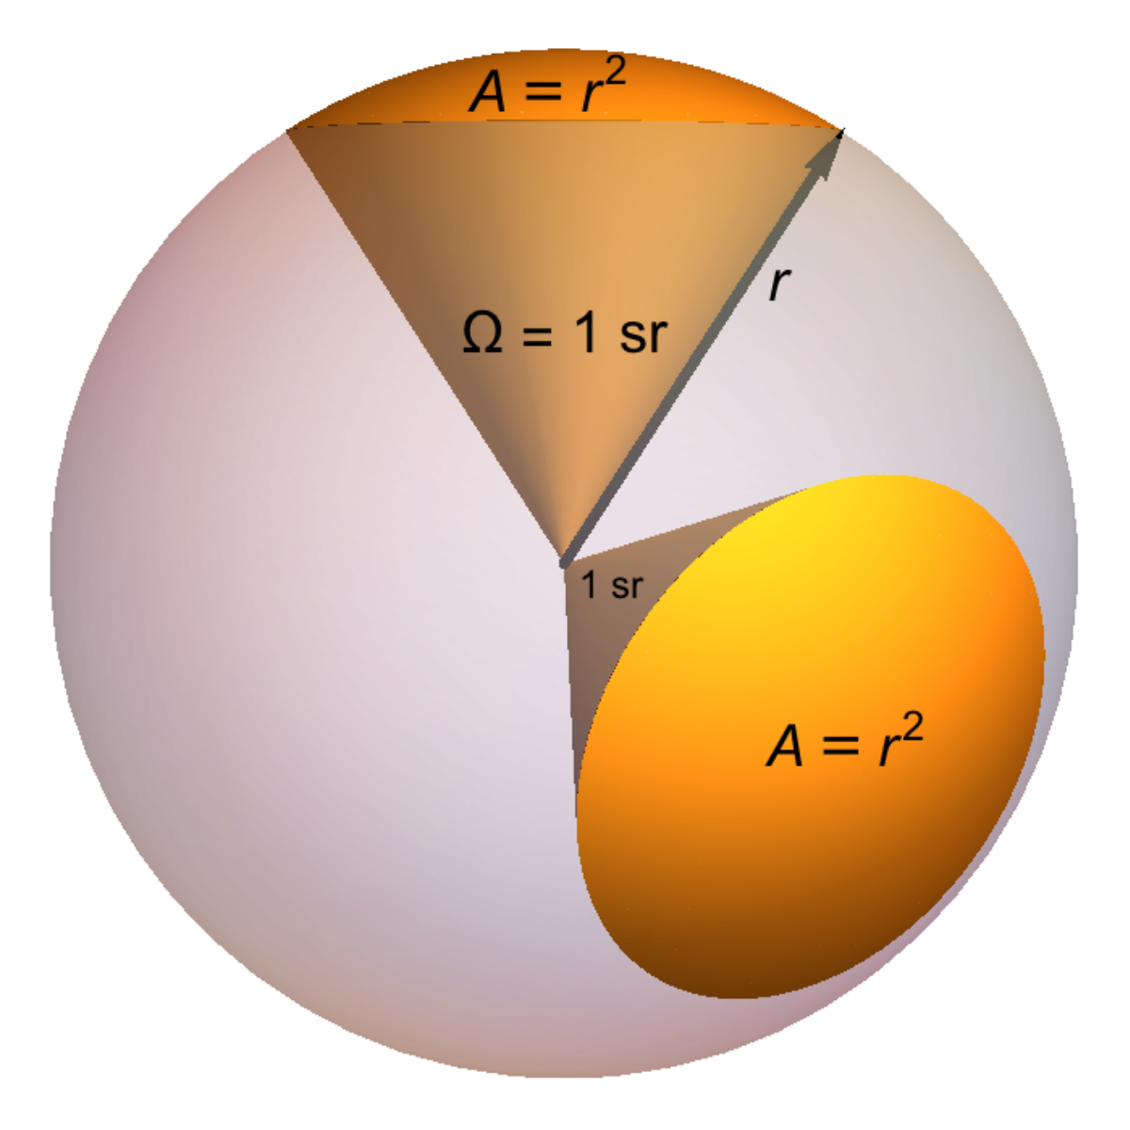

Stradian, unit of solid-angle defined as the solid angle of a sphere subtended by a portion of the surface whose area is equal to the square of the sphere's radius.

Slide 45
Prefix Symbol Factor ____ Numerically _____ Name
tera- T 10¹² 1,000,000,000,000 trillion
giga- G 10⁹ 1,000,000,000 billion
mega- M 10⁶ 1,000,000 million
kilo- k 10³ 1,000 thousand
hecto- h 10² 100 hundred
deca- D 10¹ 10 ten
base unit - 1 1 one
deci- d 10-1 0.1 tenth
centi- c 10⁻² 0.01 hundredth
milli- m 10⁻³ 0.001 thousandth
micro- μ 10⁻⁶ 0.000 001 millionth
nano- n 10⁻⁹ 0.000 000 001 billionth
pico- p 10⁻¹² 0.000 000 000 001 trillionth

Slide 46
Metric conversions
10mm = 1cm
100cm = 1m
1000m = 1km
1000g = 1kg
1000kg = 1 tonne
1000ml = 1 litre

Slide 47
Converting from Standard to Metric
Convert from: To: Multiply by:
mile kilometer (km) 1.609347
inch millimeter (mm) 25.4
inch centimeter (cm) 2.54
foot meter (m) 0.3048
yard meter (m) 0.9144

Slide 48
Converting from Metric to Standard
Convert from: To: Multiply by:
kilometer (km) mile 0.6214
millimeter (mm) inch 0.0394
centimeter (cm) inch 0.3937
meter (m) foot 3.281
meter (m) yard 1.094

